Slide 1
Microbiology Laboratory 2nd stage lab -5-
Blood & tissue sporozoa
(plasmodium & toxoplasma)

Slide 2
Plasmodium
Malaria is a disease caused by the protozoan (Haemoparasites) class sporozoa of the genus Plasmodium.
Transmitted by the female Anopheles mosquito about 60 species are able to transmit malaria.
It is a leading cause of mortality & morbidity among:
Children under five years
Pregnant women
Travellers.
5 million of people are affected every year .
At least 1.5-2 million deaths pear year annually (90% Africa).
Malaria Kills more people than AIDS.

Slide 4
General life cycle:
1. Shizogony: -Asexual reproduction in human, stages:
Ring stage of trophozoite (DS)
Mature trophozoite (DS)
Schizont (DS)
Merozoite
Gametocyte: (DS)
♀→macrogamete
♂ →Microgamete
2. Sporogony: -Sexual reproduction in mosquito, stages:
Zygote
Ookinete
Oocyst
Sporozoites (IS)

Slide 5
Plasmodium
Transmission:
Female Anopheles mosquito bite
Congenitally
Blood transfusion.

Slide 6
Plasmodium species:
P. falciparum:
P. vivax
P. ovale
P. malariea

Slide 7
Malaria
Clinical sign & symptoms:
Abrupt onset of fever and chills
Headache
Myalgia, and arthralgia,
Splenomegaly and hepatomegaly are seen in most patients,.
Anemia is prominent.

Slide 8
Pathogenesis and clinical disease:
Depends on the type of malaria:
P. falciparum:
1- It invades young and old RBC cells
2- Rapidly produces daily chills and fever as well as severe nausea, vomiting and diarrhea.
3- Involvement of the brain (cerebral malaria) injury to the brain that can result in coma and death.
4- kidney damage, resulting in an illness called “black water” fever.
5- liver involvement is characterized by abdominal pain, vomiting, hepatosplenomegally, severe diarrhea, and rapid dehydration.

Slide 9
Plasmodium
Pathogenesis and clinical disease:
P.Vivax and P.Ovale:
Fever: classically every 48 hours.
Invades only young immature erythrocytes
Infected red blood cells are usually enlarged and contain numerous pink granules or schuffner’s dots.
Gradual hepatosplenomegaly
Anemia develops slowly.
Relapse is common.

Slide 10
Plasmodium
P.malariea:
Fever: every 72 hours.
P.malariae can infect only mature RBC
Mild symptoms.

Slide 11
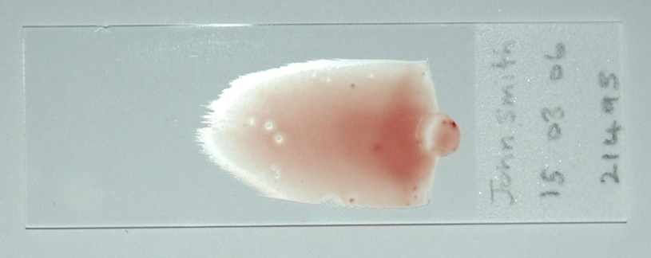
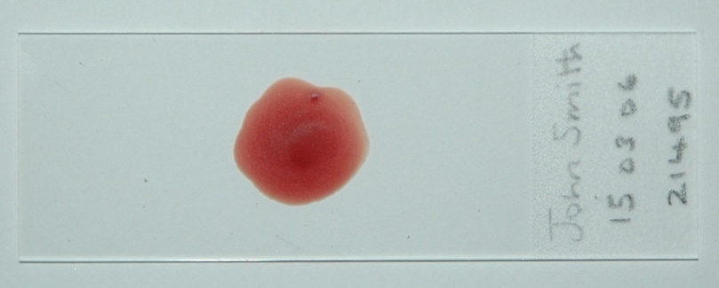
Plasmodium
Laboratory diagnosis:
Microscopic examination of thick and thin films of blood.
The thick film is a concentration method that may be used to detect the presence of organisms.
The thin film is most useful for establishing species identification.
Thin blood film Thick blood film

Slide 12
Plasmodium
Treatment:
Chloroquine is the drug of choice for acute malaria.
Schüffner’s dots: Fine,round, uniform red or red to purple dots (granule) , characteristically observed in erythrocytes infected with Plasmodium vivax and P. ovale, but not ordinarily found in P. malariae and P. falciparum infections.

Slide 13
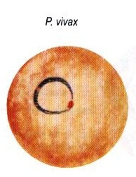
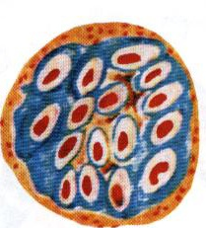
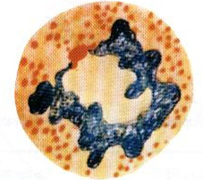
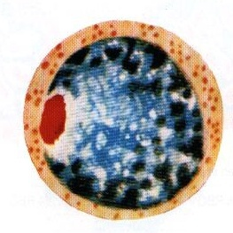
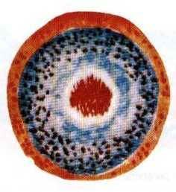
P. vivax Infected erythrocytes: enlarged up to 2X deformed; (Schüffner’s dots)
Large
Very irregular, amoeboid
Schizonts:
12-24 merozoites fill RBC
Pigment :dark yellow
Rings one fine
chromatin dots
Gametocytes: round

Slide 14
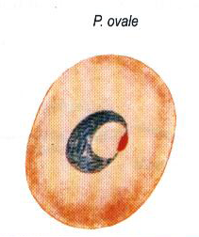
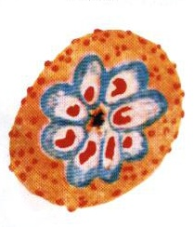
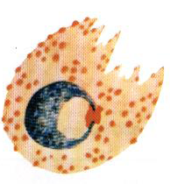
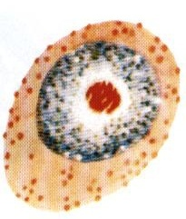
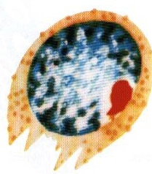
P. ovale Infected erythrocytes: enlarged oval; (Schüffner’s dots)
Compact
large irregular clump
6-14 mero. Large
Pigment :dark brown. center
Dense well defined mass
Micro- round oval
Macro- round compact
Dark blue

Slide 15
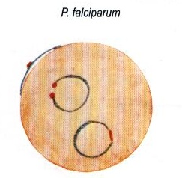
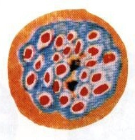
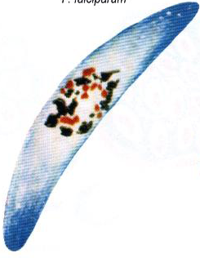
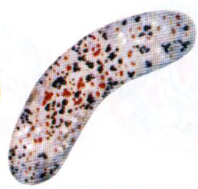
P. falciparum Infected erythrocytes: normal size (Maurer’s dots)
8-32 mero. Small
Pigment :black in center
Two fine dote
Kidney shape. Larger than RBC

Slide 16
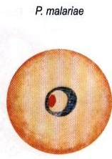
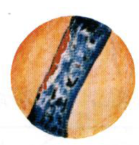
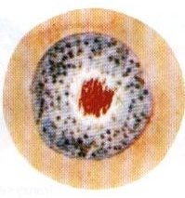
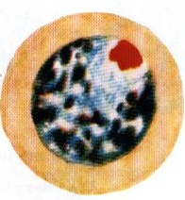
Chromatine: One mass inside ring
Chromatine:band form
Mero.6-12
Pigment :dark brown in center
Gametocytes: round
coarse,dark pigment

Slide 17
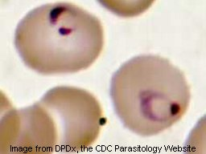
Plasmodium vivax (Trophozoites )
Trophozoites - Plasmodium vivax: Red blood cells infected by P. vivax are often larger than uninfected red blood cells. They approximately 1.5 times the size of a normal cell.

Slide 18
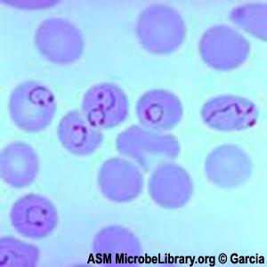
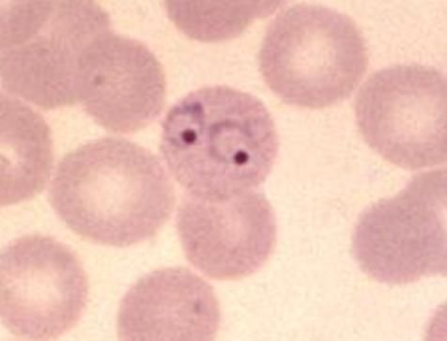
Plasmodium falciparum (trophozoite ring stage)
Trophozoites - Plasmodium falciparum: Early trophozoites have the characteristic signet ring shape. Also, unique to P. falciparum is the presence of two or multiple trophozoites in one cell.

Slide 19
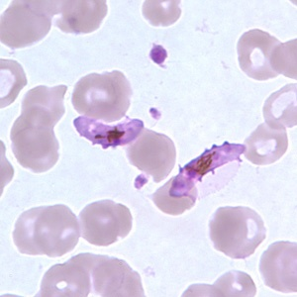
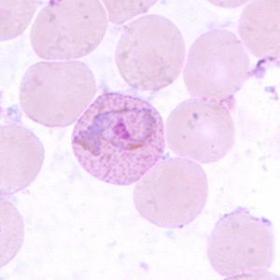
(1) Banana-shaped intraerythrocytic gametocytes identify P. falciparum infection.
(2)Enlarged erythrocytes with intracellular (Schuffner’s dots) are characteristics of P. vivax infection.

Slide 20
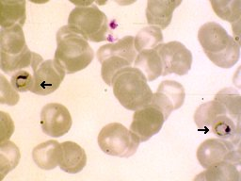
Plasmodium malariae (Trophozoites )
Characteristic trophozoites of P. malariaes showing the ring shape and the tendency of infected cells to be of normal or smaller size (arrows).

Slide 21
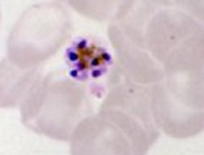
Plasmodium malariae (Schizont)
Schizont - Plasmodium malariae: A schizont containing merozoites (6 to 12) giving a coarse granular appearance.

Slide 22
Toxoplasma gondii
Disease: Toxoplasmosis.
Final host: cat
Intermediated host: human and animals, the asexual stages can cause disease in human and most animals.
Human becomes infected by:
1-Contaminated water or food by sporulated oocysts
2- Undercooked meat: Ingestion of bradyzoites (tissue cysts) of infected host.
3- Transplacentally (Mother to fetus).

Slide 23
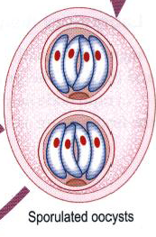
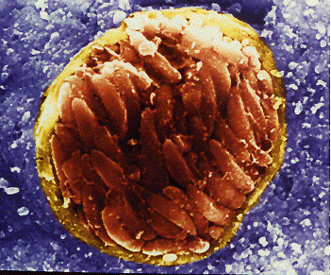
Morphology, hosts & Parasite stages:
Definitive (final) host: Domestic cats.
Eating infected rodents.
Asexual and sexual division is intracellular.
Oocysts in (feces cats).
Intermediate host: human & other animals.
Asexual tissue cycle.
Tachyzoites: (Acute phase) habits in the body fluid & tissue.
Non-motile phase in tissue cyst = Bradyzoites.

Slide 24
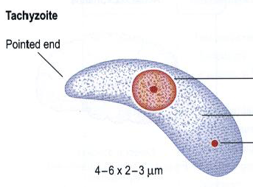
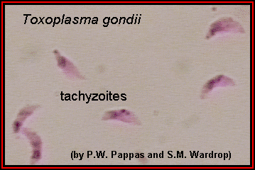
Morphology:
1- Tachyzoites
Observed in human and other intermediate host.
Ovoid or banana-shaped
Pointed anterior and rounded posterior end
Motile stage
Size 4-6µm X 2-3µm
Acute phase for infection

Slide 25
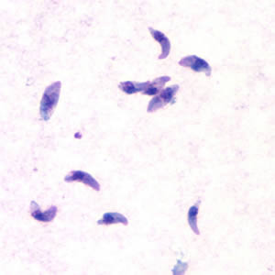
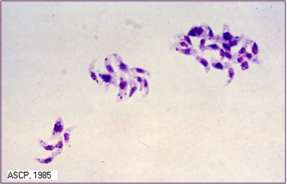
Toxoplasma gondii (trophozoite)

Slide 26
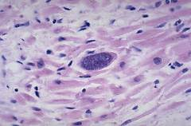
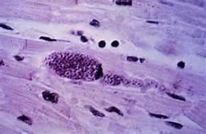
Toxoplasma gondii 2- Tissue cyst (Bradyzoites)
1- The chronic phase of infection
2- They become surrounded by host tissue and form cysts
3- located in brain, heart, skeletal muscles.

Slide 27
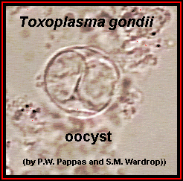
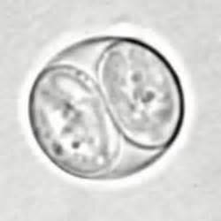
3- Oocyst
Only Cats will produce and pass oocysts
Ovoidal 10-13µm
Contains 2 sporocyst with
4 sporozoite inside each sporocyst
Oocysts appear in the cat’s feces.
require oxygen and they sporulate in 1- 5 days.

Slide 28
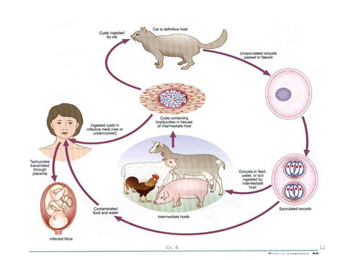

Slide 29
Pathogenesis:
Most individuals positive for T. gondii are asymptomatic or nonspecific illness.
Acute infections: characterized by parasitic invasion of the Intestinal, lymph nodes and liver parenchyma.
The most common symptom: painful, swollen lymph glands; fever, headache, muscle pain, anemia, sometimes lung complications.
Sub acute infections:
Tachyzoites continue to destroy tissues; lesions in heart, liver, lung, brain, eyes; CNS damage
Chronic infections:
formation of tissue cysts (containing bradyzoites); death of bradyzoites especially in Brain this causes formation of nodules = chronic encephalitis
In eye = blindness
Heart and lung damage

Slide 30
Congenital Toxoplasmosis:
This occurs approximately in 1 per 1000 pregnancies. It can cause severe damage to and even death of the fetus. Proliferation of tachyzoites leads to:
Intracerebral calcification
Chorioretinitis
Hydrocephaly
Microcephaly
Convulsions
Mental retardation (children)
Cardiomegaly

Slide 31
Toxoplasma
Diagnosis:
1. Direct detection and isolation of parasites from:
Peripheral blood
Amniotic fluid
Cerebrospinal fluid
Tissue section( lymph nodes, muscle,..)
2- Serology: - Detection of IgM
3. PCR
Treatment: Congenital toxoplasmosis, and disseminated disease in immunocompromised patients should be treated with a combination of sulfadiazine and pyrimethamine.

