Slide 1
Endocrine physiology
Dr. Hiwa S. Namiq
6-5-2024

Slide 2
The multiple hormone systems play a key role in regulating almost all body functions, including metabolism, growth and development, water and electrolyte balance, reproduction, and behavior. E.g. GH, T4 and T3, insulin.
The endocrine hormones are carried by the circulatory system to cells throughout the body where they bind with receptors and initiate cell reactions.
Some endocrine hormones affect many different types of cells of the body (growth hormone and thyroxine hormones)
Other hormones affect mainly specific target tissues because these tissues have abundant receptors for the hormone (adrenocorticotropic hormone specifically stimulates the adrenal cortex)

Slide 3
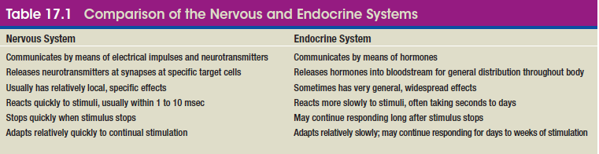
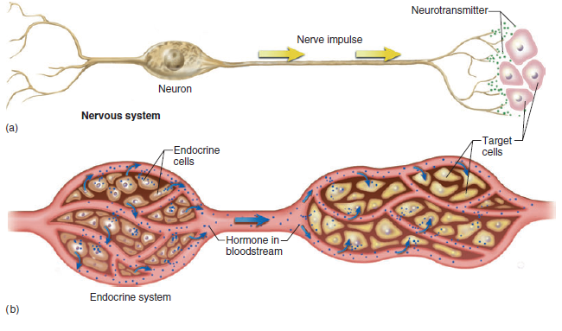
Comparison of nervous and endocrine systems

Slide 4
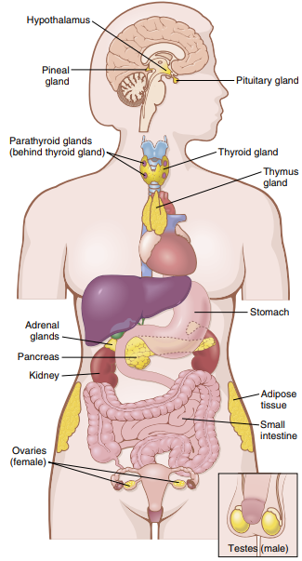

Slide 5
Types of Intercellular Communication
Neurotransmitters - released by axon to the synaptic junctions and act locally to control nerve cell functions.
Endocrine hormones - released by glands to the blood and influence the function of distant cells.
Neuroendocrine hormones -secreted by neurons to the blood and influence the function of distant cells (oxytocin).
Paracrines are secreted by cells into the extracellular fluid and affect neighboring cells of a different type (histamine, GIT hormones).
Autocrines are secreted by cells into the extracellular fluid and affect the function of the same cells that produced them (Prostaglandins).
Cytokines are peptides secreted by cells into the extracellular fluid and can function as autocrines, paracrines, or endocrine hormones (e.g. interleukins)

Slide 6
Classification of hormones
1. Proteins and polypeptide H.: as anterior and posterior pituitary hormones, the pancreatic hormones, the parathyroid gland (parathyroid hormone), and many others. Most of the hormones in the body belong to this class. They are synthesized by the cells (ER) first as inactive prohormones and later become activated in the GA.
2. Steroids H.: as adrenal cortex H. (cortisol and aldosterone), the ovaries (estrogen and progesterone), the testes (testosterone), and the placenta (estrogen and progesterone). They are usually derived from cholesterol and are highly lipid soluble, once synthesized, they simply diffuse across the cell membrane and enter the interstitial fluid and then the blood.
3. Derivatives of the amino acid tyrosine H., as thyroid (thyroxine and triiodothyronine) and the adrenal medullae (epinephrine and norepinephrine).

Slide 7
General principles about hormones.
1.Hormone release is influenced by seasonal changes, various stages of development and aging, the diurnal (daily) cycle, and sleep. For example, the secretion of growth hormone is markedly increased during the early period of sleep but is reduced during the later stages of sleep
2.Concentration ranges from as little as 1 picogram /ml of blood to a few micrograms.
3.Onset and duration of hormone secretion differ among different hormones. E.g. norepinephrine versus growth hormone.

Slide 8
4.Transport of hormones. Water-soluble hormones (peptides and catecholamines) are transported in the dissolved state in the plasma while steroid and thyroid hormones are mainly bound to plasma proteins.
5.Over-secretion or over-activity is controlled by a negative feedback effect. In a few instances, positive feedback occurs when the biological action of the hormone causes additional secretion of the hormone. E.g. surge of luteinizing hormone (LH) as a result of the stimulatory effect of estrogen on the anterior pituitary before ovulation.
Ways of hormone clearance:
Metabolic destruction by the tissues
Binding with the tissues
Excretion by the liver into the bile
Excretion by the kidneys into the urine

Slide 9
Mechanisms of action of hormones
The first step of a hormone’s action is to bind to specific receptors at the target cell. Cells that lack receptors for the hormones do not respond.
Receptors are located:
On the Cell membrane (protein, peptide, and catecholamine hormones).
In the cytoplasm (steroid hormones).
In the nucleus (thyroid hormones).

Slide 10
Intracellular signaling after hormone receptor activation
A hormone affects its target tissues by first forming a hormone-receptor complex. This alters the function of the receptor itself, and the activated receptor initiates the hormonal effects.
Types of hormone-receptor interaction:
Ion channel–linked receptors. E.g. Combination of neurotransmitters with their receptors on the postsynaptic membrane (acetylcholine and norepinephrine) and causing opening or closing a channel for one or more ions.

Slide 11
2. G protein–Linked receptors.
Here the receptor is bound to a group of cell membrane proteins called G proteins. A part of the receptor protrude into the cell cytoplasm and has coupled to G proteins. Depending on whether the protein is an inhibitory or stimulatory G protein, a hormone can either increase or decrease the activity of intracellular enzymes. The α subunit can bind either guanosine diphosphate (GDP) or GTP, and it contains GTPase activity. When GDP is bound to the α subunit, the G protein is inactive; when GTP is bound, the G protein is active
3. Enzyme-Linked receptors.
The receptor is bound to an enzyme in the inner side of the cell. When the hormone binds to the extracellular part of the receptor, the enzyme immediately inside the cell membrane is activated. E.g. leptin receptor of leptin hormone that is especially important in regulating appetite and energy balance.

Slide 12
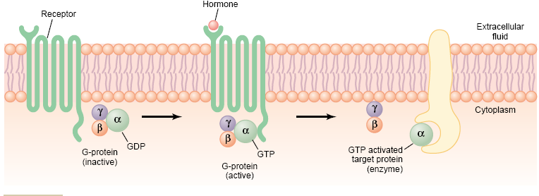
Mechanism of activation of a G protein–coupled receptor

Slide 13
Second messenger mechanisms for mediating intracellular hormonal functions
The only direct effect that some hormone has on the cell is to activate a single type of membrane receptor. The second messenger does the rest.
Types of second messenger system:
Adenylyl Cyclase–cAMP Second Messenger System.
In the previous e.g., if the G protein is stimulatory, it stimulates the adenylyl cyclase–cAMP system. Stimulation of adenylyl cyclase, a membrane- bound enzyme, by the G protein then catalyzes the conversion of a small amount of cytoplasmic ATP into cAMP inside the cell which then activates protein kinases that ultimately lead to the cell’s response to the hormone.

Slide 14
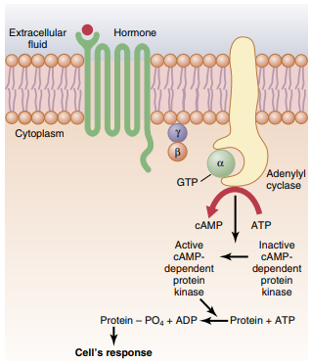

Slide 15
2. The cell membrane phospholipid second messenger system. Here the hormone activate transmembrane receptors that activate the enzyme phospholipase C attached to the inside projections of the receptors. This enzyme catalyzes the breakdown of phosphatidylinositol biphosphate (PIP2), into two different second messenger products:
Inositol triphosphate (IP3) which mobilizes calcium ions from mitochondria and the endoplasmic reticulum, and the calcium ions cause smooth muscle contraction and changes in cell secretion.
Diacylglycerol (DAG) which activates the enzyme protein kinase C (PKC), which then phosphorylates a large number of proteins, leading to the cell’s response

Slide 17
3. Calcium-Calmodulin second messenger System. In this case the hormone interacts with membrane receptors that open calcium channels. On entering a cell, calcium ions bind with the protein calmodulin which cause either activation or inhibition of protein kinases.
The different responses of cells to the second messenger include muscle contraction, new protein synthesis, gland secretion, transport…etc.

Slide 18
Pituitary gland and its relation to the hypothalamus
Pituitary Gland: Two distinct parts–The anterior and posterior lobes.
The pituitary gland (hypophysis) is a small gland—about 0.5 to 1 gram in weight— that lies in the sella turcica, a bony cavity at the base of the brain, and is connected to the hypothalamus by the pituitary (or hypophysial) stalk. Physiologically, the pituitary gland is divided into two distinct portions: the anterior pituitary, also known as the adenohypophysis, and the posterior pituitary, also known as the neurohypophysis.

Slide 19
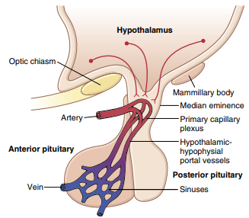
Hypothalamic-hypophysial portal system

Slide 20
  Six important peptide hormones are secreted by the anterior pituitary, and two important peptide hormones are secreted by the posterior pituitary. The hormones of the anterior pituitary play major roles in the control of metabolic functions throughout the body.

Slide 21
Growth hormone promotes growth of the entire body (protein formation, cell multiplication, and cell differentiation).
Adrenocorticotropin (corticotropin) controls the secretion of some of the adrenocortical hormones, which affect the metabolism of glucose, proteins, and fats.
Thyroid-stimulating hormone (thyrotropin) controls the rate of secretion of thyroxine and triiodothyronine by the thyroid gland, and these hormones control the rates of most intracellular chemical reactions in the body.
Prolactin promotes mammary gland development and milk production.
Two separate gonadotropic hormones, follicle-stimulating hormone and luteinizing hormone, control growth of the ovaries and testes, as well as their hormonal and reproductive activities.
The two hormones secreted by the posterior pituitary play other roles.
Antidiuretic hormone (also called vasopressin) controls the rate of water excretion into the urine, thus helping to control the concentration of water in the body fluids.
Oxytocin helps express milk from the glands of the breast to the nipples during suckling and possibly helps in the delivery of the baby at the end of gestation.

Slide 23
Almost all secretion by the pituitary is controlled by either hormonal or nervous signals from the hypothalamus.
Control of anterior pituitary:
The anterior pituitary is a highly vascular gland with extensive capillary sinuses among the glandular cells. Almost all the blood that enters these sinuses passes first through another capillary bed in the lower hypothalamus. The blood then flows through small hypothalamic-hypophysial portal blood vessels into the anterior pituitary sinuses
Control of the posterior pituitary:
The bodies of the cells that secrete the posterior pituitary hormones are not located in the pituitary gland itself but are large neurons in the hypothalamus. The hormones are then transported in the axoplasm of the neurons’ nerve fibers passing from the hypothalamus to the posterior pituitary gland

Slide 24
The major hypothalamic releasing and inhibitory hormones are the following
1.Thyrotropin-releasing hormone (TRH), which causes release of thyroid-stimulating hormone
2. Corticotropin-releasing hormone (CRH), which causes release of adrenocorticotropin
3. Growth hormone–releasing hormone (GHRH), which causes release of growth hormone, and growth hormone inhibitory hormone (GHIH), also called somatostatin, which inhibits release of growth hormone
4. Gonadotropin-releasing hormone (GnRH), which causes release of the two gonadotropic hormones, luteinizing hormone and follicle-stimulating hormone
5. Prolactin inhibitory hormone (PIH), which causes inhibition of prolactin secretion

Slide 25
Growth hormone
Physiological functions of GH (somatotropin)
Growth hormone causes growth of almost all tissues of the body that are capable of growing.
Metabolic Effects.
(1) increased rate of protein synthesis in most cells of the body.
(2) increased mobilization of fatty acids from adipose tissue, increased free fatty acids in the blood, and increased use of fatty acids for energy.
(3) decreased rate of glucose utilization throughout the body.
Stimulates Cartilage and Bone Growth.
(1) increases deposition of protein by the chondrocytic and osteogenic cells that cause bone growth.
(2) increases rate of reproduction of these cells.
(3) causes deposition of new bone through its effect of converting chondrocytes into osteogenic cells. (epiphysis fuses with the shaft at late adolescence).

Slide 26
Regulation of growth hormone secretion:
Growth hormone is secreted in a pulsatile pattern, increasing and decreasing. The secretion is controlled by two factors secreted in the hypothalamus and then transported to the anterior pituitary gland through the hypothalamic-hypophysial portal vessels. They are growth hormone–releasing hormone and growth hormone inhibitory hormone (also called somatostatin).
Growth hormone is secreted primarily during the period of growth. After adolescence, secretion decreases slowly with aging, finally falling to about 25 per cent of the adolescent level in very old age.

Slide 28
Posterior pituitary gland and its relation to the hypothalamus
The neurons from the hypothalamus secrete two hormones into the posterior pituitary gland through the pituitary stalk.
Antidiuretic hormone (ADH) (vasopressin).
Oxytocin.
Both oxytocin and ADH (vasopressin) are polypeptides, each containing nine amino acids.

Slide 29
Physiological functions of ADH
At extremely Low quantities, ADH causes decreased excretion of water by the kidneys (Antidiuretic). In the absence of ADH, the collecting tubules and ducts become almost impermeable to water, which prevents significant reabsorption of water and therefore allows extreme loss of water into the urine, also causing extreme dilution of the urine.
At Higher concentrations, ADH is a potent arteriolar vaso-constrictor throughout the body and therefore increasing the arterial pressure (vasopressin).
The concentration of ADH in the body fluids is controlled by the osmotic concentration of the extracellular fluid. When the extracellular fluid becomes too concentrated, it initiates signals in the hypothalamus to cause additional ADH secretion and vice versa.

Slide 31
Functions of Oxytocin
The hormone oxytocin powerfully stimulates contraction of the pregnant uterus, especially toward the end of gestation.
During lactation, oxytocin causes milk to be expressed from the alveoli into the ducts of the breast so that the baby can obtain it by suckling.

Slide 32

Thyroid Hormones
The thyroid gland is one of the largest of the endocrine glands, normally weighing 15 to 20 grams in adults.
The thyroid secretes two major hormones, thyroxine and triiodothyronine, commonly called T4 and T3, respectively.
Both of these hormones profoundly increase the metabolic rate of the body. Complete lack of thyroid secretion usually causes the basal metabolic rate to fall 40 to 50 per cent below normal, and extreme excesses of thyroid secretion can increase the basal metabolic rate to 60 to 100 per cent above normal.

Slide 34
Thyroid secretion is controlled primarily by thyroid-stimulating hormone (TSH) secreted by the anterior pituitary gland.
About 93 per cent of the metabolically active hormones secreted by the thyroid gland is thyroxine, and 7 per cent triiodothyronine. However, almost all the thyroxine is eventually converted to triiodothyronine in the tissues, so that both are functionally important.

Slide 35
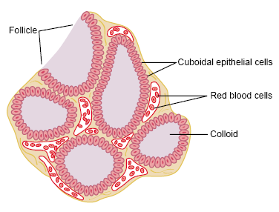

Slide 36
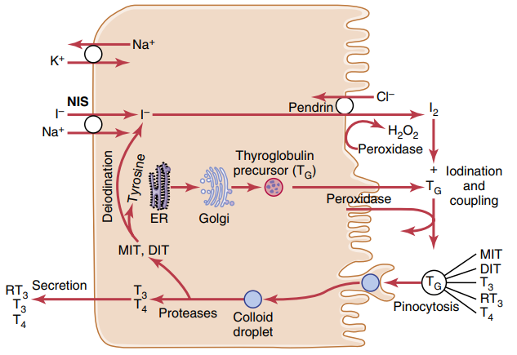
Thyroid cellular mechanisms for iodine transport, thyroxine and triiodothyronine formation, and thyroxine and triiodothyronine release into the blood. DIT, Diiodotyrosine; ER, endoplasmic reticulum; I−, iodide ion; I2, iodine; MIT, monoiodotyrosine; NIS, sodium-iodide symporter; RT3, reverse triiodothyronine; T3, triiodothyronine; T4, thyroxine; TG, thyroglobulin.

Slide 37
On entering the blood, over 99 per cent of the thyroxine and triiodothyronine combines immediately with several of the plasma proteins, all of which are synthesized by the liver. They combine mainly with thyroxine-binding globulin and much less to thyroxine-binding prealbumin and albumin.

Slide 38
On entering the tissue cells, both thyroxine and triiodothyronine again bind with intracellular proteins and they are used slowly over a period of days or weeks.
Thyroid H. have slow onset and long duration of action reaching maximum effect over 10 – 12 days and then decreasing with a half life of 15 days. T3 action occur four times as rapidly as T4 action.

Slide 39
Physiologic functions of the thyroid hormones
Thyroid hormones increase the transcription of large numbers of genes.
Before acting on the genes to increase genetic transcription, one iodide is removed from almost all the thyroxine (90% of T4), thus forming triiodothyronine. The thyroid hormone receptors are either attached to the DNA genetic strands or located in proximity to them.
Large numbers of different types of messenger RNA are formed, followed by RNA translation on the cytoplasmic ribosomes to form hundreds of new intracellular proteins.
Most, if not all, of the actions of thyroid hormone result from the subsequent enzymatic functions of these new proteins.

Slide 40
Thyroid hormones increase cellular metabolic activity as follows:
The basal metabolic rate can increase to 60 to 100 per cent above normal.
The rate of utilization of foods for energy is greatly accelerated.
The rate of both protein synthesis and protein catabolism is increased.
The growth rate of young people is greatly accelerated.
The mental processes are excited.
The activities of most of the other endocrine glands are increased.

Slide 42
Regulation of thyroid hormone secretion
TSH from the anterior pituitary increases the secretion of thyroxine (T4) and triiodothyronine (T3) by the thyroid gland.
The most important early effect after administration of TSH is to initiate proteolysis of the thyroglobulin, which causes release of thyroxine and triiodothyronine into the blood within 30 minutes.
TSH secretion is controlled by a hypothalamic hormone, thyrotropin-releasing hormone (TRH), which is secreted by nerve endings in the median eminence of the hypothalamus.
One of the best-known stimuli for increasing the rate of TRH secretion by the hypothalamus is cold results from excitation of the hypothalamic centers for body temperature control.
While excitement and anxiety —conditions that greatly stimulate the sympathetic nervous system—cause an acute decrease in secretion of TSH.
Increased thyroid hormone in the body fluids (about 1.75 times) directly decreases secretion of TSH by the anterior pituitary as a negative feedback mechanism. (Negative FB control).

Slide 43
Diseases of the Thyroid
Hyperthyroidism.
The thyroid gland is increased to 2-3 times normal size, with tremendous hyperplasia and the number of cells is increased greatly. Also, each cell increases its rate of secretion several fold. In most of patients antibodies are found in the blood that bind with the same membrane receptors that bind TSH.
Hyperthyroidism can also result from a localized adenoma (a tumor) that develops in the thyroid tissue and secretes large quantities of thyroid hormone.

Slide 44
Symptoms of Hyperthyroidism
High state of excitability.
Intolerance to heat.
Increased sweating.
Mild to extreme weight loss
Varying degrees of diarrhea.
Muscle weakness.
Nervousness or other psychic disorders.
Extreme fatigue but inability to sleep.
Tremor of the hands.
Exophthalmos.

Slide 46
Hypothyroidism
The effects of hypothyroidism, in general, are opposite to those of hyperthyroidism.
Causes:
1-Autoimmunity against the thyroid gland, but immunity that destroys the gland rather than stimulates it.
2-Iodide deficiency from the diet which produces endemic colloid goiter.
3-Idiopathic Nontoxic Colloid Goiter.

Slide 47
How goiter is produced?
Lack of iodine prevents production of both thyroxine and triiodothyronine. As a result, no hormone is available to inhibit production of TSH by the anterior pituitary; this causes the pituitary to secrete excessively large quantities of TSH. The TSH then stimulates the thyroid cells to secrete tremendous amounts of thyroglobulin colloid into the follicles, and the gland grows larger and larger.

Slide 48
Characteristics of Hypothyroidism
Fatigue and extreme somnolence with sleeping up to 12 to 14 hours a day.
Extreme muscular sluggishness
Slowed heart rate, decreased cardiac output, decreased blood volume,
Increased body weight,
Constipation,
Mental sluggishness,
Failure of many trophic functions in the body evidenced by depressed growth of hair and scaliness of the skin,
Husky voice
Myxedema (development of an edematous appearance) in severe cases.

Slide 50
Cretinism
Cretinism is caused by extreme hypothyroidism during fetal life, infancy, or childhood. This condition is characterized especially by failure of body growth and by mental retardation. It results from congenital lack of a thyroid gland (congenital cretinism), from failure of the thyroid gland to produce thyroid hormone because of a genetic defect of the gland, or from iodine lack in the diet (endemic cretinism).

Slide 51
Adrenocortical Hormones

Slide 52
The two adrenal glands lie at the superior poles of the two kidneys.
Each gland is composed of two distinct parts, the adrenal medulla and the adrenal cortex.
The adrenal medulla, the central 20 per cent of the gland, is functionally related to the sympathetic nervous system; it secretes the hormones epinephrine and norepinephrine in response to sympathetic stimulation. In turn, these hormones cause almost the same effects as direct stimulation of the sympathetic nerves in all parts of the body.
The adrenal cortex secretes corticosteroids. These hormones are all synthesized from the steroid cholesterol.
The two major types of corticosteroid hormones are:
Mineralocorticoids
Glucocorticoids
In addition, small quantities of androgenic hormones are also secreted.

Slide 53
Functions of the Mineralocorticoids- Aldosterone
Without mineralocorticoids, potassium ion concentration of the extracellular fluid rises markedly, sodium and chloride are rapidly lost from the body, and the total extracellular fluid volume and blood volume become greatly reduced. The person soon develops diminished cardiac output, which progresses to a shock like state, followed by death.

Slide 54
Aldosterone increases absorption of sodium and simultaneously increases secretion of potassium by the renal tubular epithelial. Therefore, aldosterone causes sodium to be conserved in the extracellular fluid while increasing potassium excretion in the urine.
Sodium reabsorption is followed by osmotic absorption of almost equivalent amounts of water.
Aldosterone also stimulates thirst and increased water intake, therefore, the extracellular fluid volume increases almost as much as the retained sodium, but without much change in sodium concentration. The result is a rise in blood pressure of about 15 - 25 mm Hg which in turn increases kidney excretion of both salt and water (pressure natriuresis and pressure diuresis).

Slide 55
In the sweat and salivary glands aldosterone greatly increases the reabsorption of sodium chloride and the secretion of potassium by the ducts of these gland. This is important to conserve body salt in hot environments, and when excessive quantities of saliva are lost.

Slide 56
Regulation of aldosterone secretion
The regulation of aldosterone secretion is almost entirely independent of the regulation of cortisol and androgen secretion.
Four factors play an essential role in the regulation of aldosterone secretion:
1.Increased potassium ion concentration in the extracellular fluid greatly increases aldosterone secretion.
2. Increased activity of the renin-angiotensin system (increased levels of angiotensin II) also greatly increases aldosterone secretion.
3. Increased sodium ion concentration in the extracellular fluid very slightly decreases aldosterone secretion.
4. ACTH from the anterior pituitary gland is necessary for aldosterone secretion but has little effect in controlling the rate of secretion.

Slide 57
Functions of the Glucocorticoids
At least 95 per cent of the glucocorticoid activity of the adrenocortical secretions results from the secretion of cortisol, known also as hydrocortisone. In addition to this, a small but significant amount of glucocorticoid activity is provided by corticosterone.
The glucocorticoids are necessary, allowing the person to resist the destructive effects of life’s intermittent physical and mental “stresses”.

Slide 58
Effects of Cortisol
Carbohydrate Metabolism.
Cortisol stimulates gluconeogenesis (formation of carbohydrate from proteins and other substances) by the liver. It also causes a moderate decrease in the rate of glucose utilization by most cells in the body. Both of these effects cause the blood glucose concentration to rise (some time producing adrenal diabetes) which in turn stimulates secretion of insulin.
Protein Metabolism. Cortisol reduces protein stores in essentially all body cells (especially the muscle and lymphoid tissue) except those of the liver. This is caused by both decreased protein synthesis and increased catabolism of protein already in the cells.
In the presence of great excesses of cortisol, the muscles can become very weak and the immunity functions of the lymphoid tissue is greatly decreased. But at the same time liver proteins become enhanced and the plasma proteins are also increased.

Slide 59
Fat Metabolism. Cortisol promotes mobilization of fatty acids from adipose tissue which increases the concentration of free fatty acids in the plasma, thereby increasing their utilization for energy.
Many people with excess cortisol secretion develop obesity, with excess deposition of fat in the chest and head regions of the body, giving a buffalo-like torso and a rounded “moon face.”

Slide 60
Role of cortisol in resisting Stress and Inflammation
Almost any type of stress, whether physical or neurogenic, causes an immediate and marked increase in ACTH secretion followed within minutes by greatly increased secretion of cortisol.
Some of the different types of stress that increase cortisol release are the following:
1.Trauma of almost any type
2. Infection
3. Intense heat or cold
4. Surgery
5. Almost any debilitating disease

Slide 61
Anti-inflammatory effects of high levels of cortisol.
Large amounts of cortisol can usually block the inflammation or even reverse many of its effects.
The two basic anti-inflammatory effects of cortisol are (1) it can block the early stages of the inflammatory process (2) if inflammation has already begun, it causes rapid resolution of the inflammation and increased rapidity of healing.
Because it reduces inflammation and the release of inflammatory products, cortisol effectively prevents shock or death in anaphylaxis.
Cortisol also decreases the number of eosinophils and lymphocytes in the blood.

Slide 62
Regulation of cortisol secretion
Secretion of cortisol is controlled almost entirely by ACTH secreted by the anterior pituitary gland. The ACTH itself is controlled by corticotropin- releasing factor (CRF) from the hypothalamus.
Physical or mental stress causes secretion of hypothalamic CRF into the hypophysial portal system that can lead within minutes to greatly enhanced secretion of ACTH and consequently cortisol.

Slide 63
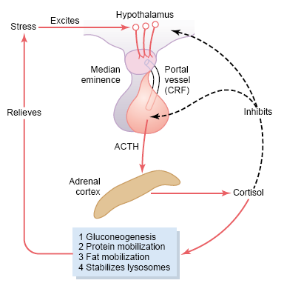
Mechanism for regulation of glucocorticoid (cortisol) secretion

Slide 64
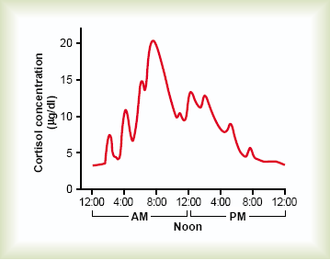

Slide 65
Hyperadrenalism-Cushing’s Syndrome
Most of the abnormalities of Cushing’s syndrome are ascribable to abnormal amounts of cortisol, but excess secretion of androgens may also cause important effects.
Causes of hypercortisolism:
Adenomas of the anterior pituitary that secrete large amounts of ACTH
Hypersecretion of corticotropic releasing factor (CRF) by the hypothalamus.
Ectopic ACTH secretion by some abdominal tumors.
Adenoma of the adrenal cortex.
Cushing’s syndrome can also occur when large amounts of glucocorticoids are administered over prolonged periods for therapeutic purposes such as for rheumatoid arthritis.
When Cushing’s syndrome is secondary to excess secretion of ACTH by the anterior pituitary, this is referred to as Cushing’s disease.

Slide 66
Features of Cushing's syndrome
Buffalo torso, due to extra deposition of fat in the thoracic and upper abdominal regions,
Edematous appearance of the face (moon face),
Acne and hirsutism (excess growth of facial hair)
About 80 per cent of patients have hypertension, presumably because of the slight mineralocorticoid effects of cortisol.
Increased blood glucose concentration.
Decreased tissue protein anywhere in the body but specially in the muscles (sever weakness), in the lymphoid tissue (depressed immune response), in the skin (stria) and in the bones (osteoporosis).

Slide 67
Insulin, Glucagon, and
Diabetes Mellitus

Slide 68
The pancreas, in addition to its digestive functions, secretes two important hormones, insulin and glucagon, that are crucial for normal regulation of glucose, lipid, and protein metabolism.
The pancreas is composed of two major types of tissues:
(1) The acini, which secrete digestive juices into the duodenum.
(2) The islets of Langerhans, which secrete insulin (beta cells), glucagon (alpha cells) and somatostatin (delta cells) directly into the blood.

Slide 69
Insulin hormone
When there is great abundance of energy-giving foods in the diet, especially excess amounts of carbohydrates, insulin is secreted in great quantity. In turn, the insulin plays an important role in storing the excess energy.
In the case of excess carbohydrates, it causes them to be stored as glycogen mainly in the liver and muscles. Also, all the excess carbohydrates that cannot be stored as glycogen are converted under the stimulus of insulin into fats and stored in the adipose tissue.

Slide 70
In the case of proteins, insulin has a direct effect in promoting amino acid uptake by cells and conversion of these amino acids into protein. In addition, it inhibits the breakdown of the proteins that are already in the cells. Therefore it has protein anabolic effect.
Insulin first binds with and activates a membrane receptor that functions as an enzyme-linked receptor.

Slide 71
Effect of Insulin on Carbohydrate
Metabolism
Immediately after a high-carbohydrate meal, the glucose that is absorbed into the blood causes rapid secretion of insulin. The insulin in turn causes rapid uptake, storage, and use of glucose by almost all tissues of the body, but especially by the muscles, adipose tissue, and liver.
If the muscles are not exercising after a meal, most of the glucose is stored in the form of muscle glycogen instead of being used for energy. The glycogen can later be used for energy by the muscle.
The brain cells are permeable to glucose and can use glucose without the intermediation of insulin.

Slide 72
Between meals, when food is not available and the blood glucose concentration begins to fall, insulin secretion decreases rapidly and the liver glycogen is split back into glucose, which is released back into the blood to keep the glucose concentration from falling too low.
When the quantity of glucose entering the liver cells is more than can be stored as glycogen or can be used for local hepatocyte metabolism, insulin promotes the conversion of all this excess glucose into fatty acids. These fatty acids are subsequently packaged as triglycerides and stored in adipose tissue.

Slide 73
Effect of Insulin on Fat Metabolism
Insulin decreases the utilization of fat and promotes fatty acid synthesis.
Fat breakdown and using fat for energy are greatly enhanced in the absence of insulin. This occurs even normally between meals when secretion of insulin is minimal, but it becomes extreme in diabetes mellitus. The two major products of fat metabolism are phospholipids and cholesterol, that is why insulin deficiency promotes the development of atherosclerosis in people with serious diabetes.

Slide 74
Effect of Insulin on Protein Metabolism and on Growth
During the few hours after a meal, insulin promotes transport and storage of protein by the tissues and prevents the degradation of proteins. Both insulin and growth hormone interact synergistically to promote growth.

Slide 76
Increased blood glucose concentration is the primary controller of insulin secretion

Slide 77
Glucagon and Its Functions
Glucagon is secreted by the alpha cells of the islets of Langerhans when the blood glucose concentration falls. Its functions opposes that of the insulin.
The major effects of glucagon on glucose metabolism are:
(1) Breakdown of liver glycogen (glycogenolysis)
(2) Increased gluconeogenesis in the liver.
Both of these effects greatly enhance the availability of glucose to the other organs of the body.
Glucagon also makes fatty acids available to the energy systems of the body and inhibits the storage of triglycerides in the liver.

Slide 78
Diabetes Mellitus
Diabetes mellitus is a syndrome of impaired carbohydrate, fat, and protein metabolism caused by either lack of insulin secretion or decreased sensitivity of the tissues to insulin.
1- Type I diabetes, also called insulin-dependent diabetes mellitus (IDDM), is caused by lack of insulin secretion.
2- Type II diabetes, also called non–insulin-dependent diabetes mellitus (NIDDM), is caused by decreased sensitivity of target tissues to the metabolic effect of insulin

Slide 79
Type I Diabetes—Lack of Insulin
Injury to the beta cells of the pancreas (e.g. Viral infections or autoimmune disorders) can lead to type I diabetes. Heredity also plays a major role.
The usual onset of type I diabetes occurs at about 14 years of age (juvenile diabetes mellitus).

Slide 80
Type II Diabetes—Resistance to the
Metabolic Effects of Insulin
Type II diabetes is far more common than type I (about 90 per cent of all cases of DM)
In most cases, the onset of type II diabetes occurs after age 30, often between the ages of 50 and 60 (adult-onset diabetes).
Obesity, insulin resistance (why), and “Metabolic Syndrome” usually precede development of Type II Diabetes.

Slide 81
Insulin resistance is part of a cascade of disorders that Is often called the “metabolic syndrome.” Some of the features of the metabolic syndrome include:
Obesity, especially accumulation of abdominal fat
Insulin resistance
Fasting hyperglycemia
Lipid abnormalities such as increased blood triglycerides and decreased blood high-density lipoprotein-cholesterol
Hypertension

Slide 82
Importance of Blood Glucose Regulation, why?
Glucose is the only nutrient that normally can be used by the brain, retina, and germinal epithelium of the gonads.
Glucose can exert a large amount of osmotic pressure in the extracellular fluid, therefore cellular dehydration.
An excessively high level of blood glucose concentration causes loss of glucose in the urine, followed by osmotic diuresis by the kidneys, which can deplete the body of its fluids and electrolytes.
Long-term increases in blood glucose may cause damage to many tissues, especially to blood vessels leading to increased risk for heart attack, stroke, end-stage renal disease, and blindness.

