Slide 1
Nematodes & Cestodes
Lab-6-

Slide 2
Nematode(round worm) Wuchereria bancrofti
Wuchereria is thread-like worm that lies coiled in the lymphatic vessels.
Wuchereria bancrofti causes lymphatic filariasis ( Elephantiasis).
Transmission and reservoirs: W. bancrofti, transmitted primarily by mosquitoes of the Anopheles or Culex species.
Infective stage: larva 3

Slide 4
Wuchereria bancrofti
Laboratory Diagnosis:
Thick blood smears taken from the patient at night reveal the microfilariae.
Treatment:
Diethylcarbamazine citrate (DEC)is the drug of choice

Slide 5
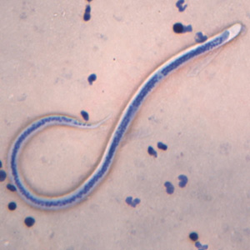
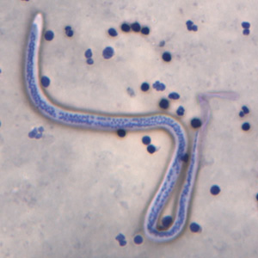
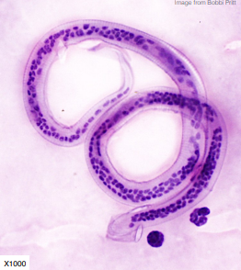
Wuchereria bancrofti

Slide 6
Cestodes (Tape worm) Echinococcus
Echinococcus granulosus and Echinococcus multilocularis (Hydatid worm or Hyper Tape-worm).
The larva of Echinococcus granulosus (dog tapeworm) causes unilocular hydatid cyst disease.
Multilocular hydatid disease is caused by Echinococcus multilocularis, which is a minor pathogen.
E. granulosus is composed of a scolex, undifferentiated neck region and only three proglottids, making it one of the smallest tapeworms

Slide 7
Echinococcus
Transmission:
Dogs, the definitive host, are infected by eating contaminated meat, humans like the usual intermediate hosts, become infected following ingestion of eggs passed in dogs feces.
Clinical disease:
In humans, E. granulosus cause echinococcosis (hydatid disease).
A. Most cyst occur in the liver or lungs.
B. Cysts in bone, the CNS, heart, and kidney carry a serious prognosis.

Slide 8
Echinococcus
Diagnosis:
Radiographs, ultrasound, and computed tomography (CT) scan are helpful visualizing cysts.
Routine histology: Echinococcus species can detected in aspirates or biopsies of liver or lungs.
Serological tests.
Treatment:
Albendazole is the drug of choice.
Surgical removal of cysts may follow successful treatment.

Slide 9
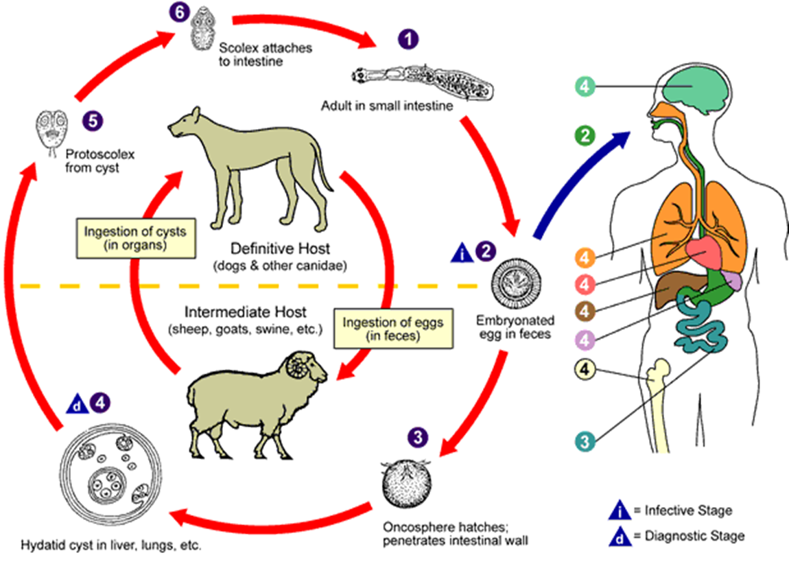

Slide 10
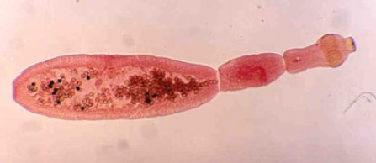
Echinococcus

Slide 11
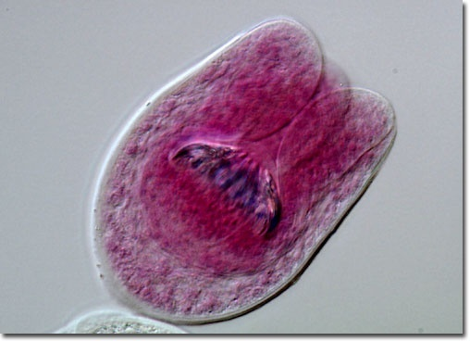
E. Granulosus scolex

Slide 12
Echinococcus

