Slide 1
Examination of the motor system
Enas Sabah
MSc. Human Physiology

Slide 2
Examination of the motor system
It includes the following:
    Size, tone and power of the muscles
    Coordination of movement
    Gait
    Reflexes

Slide 3
Reflexes:
Reflex is an involuntary response to a stimulus and it is the basic integrated function of the nervous system.
Components of a reflex arc include:
Receptor.
Afferent (sensory) pathway
Central integrating part ( Spinal cord, Brain stem, Cerebral cortex)
Efferent (motor) pathway
Effector organ ( Muscle or gland)

Slide 4
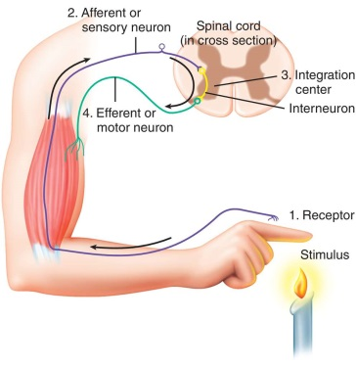

Slide 5
Classification of reflexes:
According to whether it is inborn or acquired.
According to site of integration ( Spinal cord, Brain stem, Cerebral cortex).
According to movement involved (extensor or flexor reflex).
According to the number of synapses (monosynaptic or polysynaptic reflex).
According to depth (superficial or deep reflex).

Slide 6
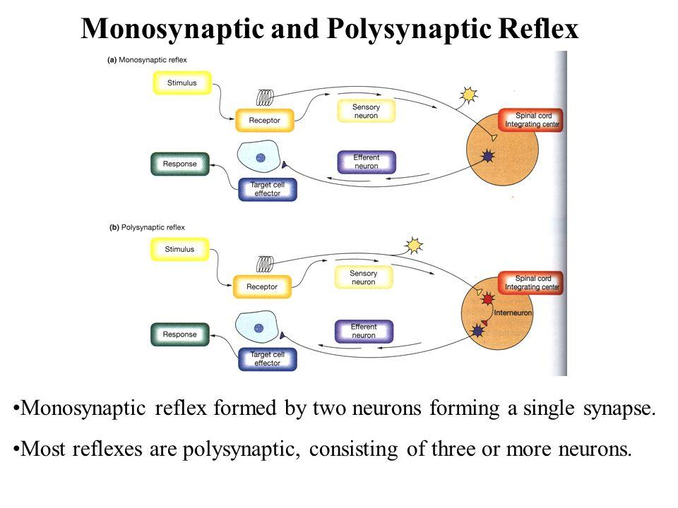

Slide 7
Superficial reflexes:
are responses to stimuli on the skin or mucous membranes. The main superficial reflexes include:
Abdominal Reflex: T11,T12
  Stroking the skin of the abdomen stimulates contraction of the abdominal muscles.
Cremasteric Reflex (in males):L1,2
  Stroking the inner thigh causes contraction of the cremaster muscle and elevation of the testis on the same side.
Plantar Reflex (Babinski Reflex): L5,S1
  Stroking the sole of the foot from heel to toe along the outer edge causes the toes to curl inward (normal response). An abnormal response (Babinski sign) is the extension of the big toe and fanning of the other toes, which is normal in infants but indicates a neurological problem in adults.
Anal Reflex:
  Stroking the skin around the anus causes contraction of the external anal sphincter.

Slide 8
5. Corneal Reflex (Blink Reflex):
  Stimulus: Touching the cornea of the eye, typically with a wisp of cotton or a puff of air.
  Response: Both eyes blink in response to the stimulus.
6. Gag Reflex (Pharyngeal Reflex):
  Stimulus: Touching the posterior pharyngeal wall, soft palate, or base of the tongue.
  Response: Contraction of the pharyngeal muscles, causing gagging.

Slide 9
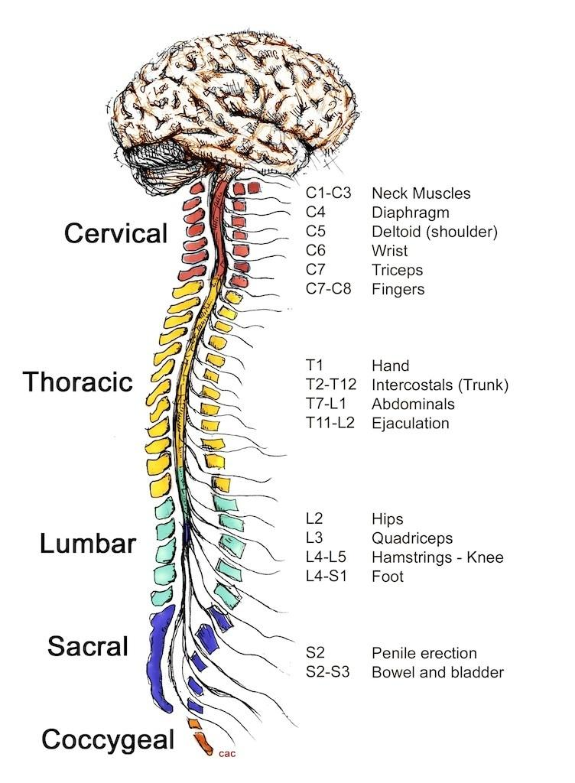

Slide 10
Deep tendon reflexes
Biceps Reflex (C5-C6):
  Tapping the biceps tendon in the antecubital fossa.
  Response: Contraction of the biceps muscle, causing flexion of the elbow.
Brachioradialis Reflex (C5-C6):
  Tapping the brachioradialis tendon at the forearm, about 1-2 inches above the wrist.
  Response: Contraction of the brachioradialis muscle, resulting in flexion and supination of the forearm.
Triceps Reflex (C7-C8):
  Tapping the triceps tendon just above the elbow.
  Response: Contraction of the triceps muscle, causing extension of the elbow.
Notes:
"C7-C8" refers to the spinal nerve roots and segments of the spinal cord that are involved in the reflex.

Slide 11
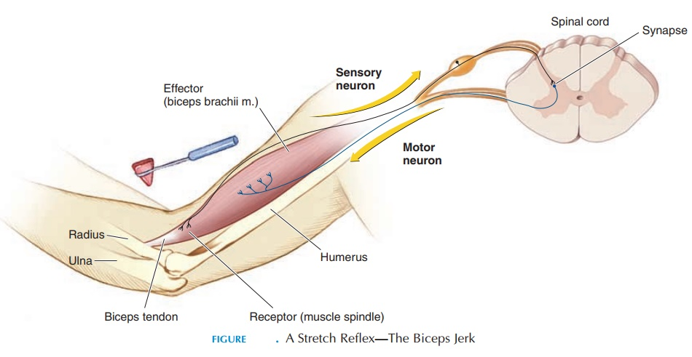

Slide 12
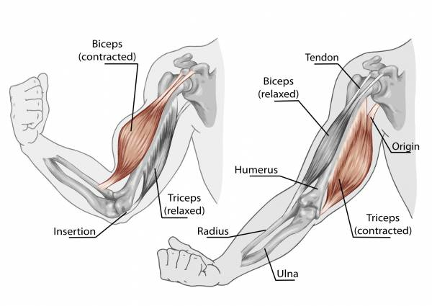

Slide 13
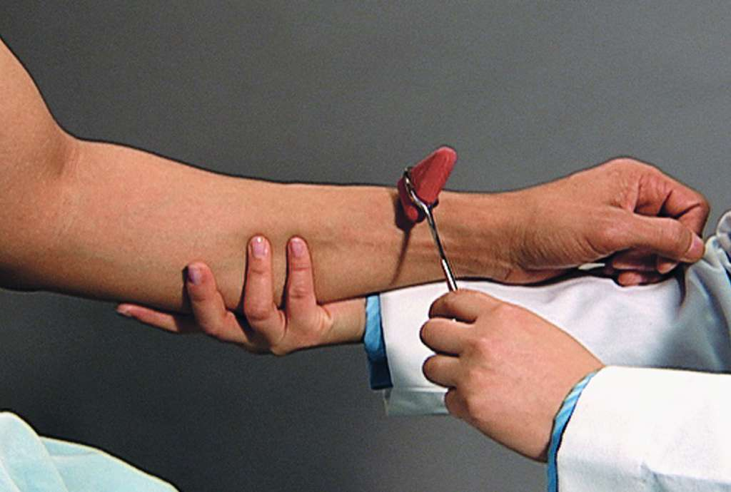
Brachioradialis Reflex

Slide 14
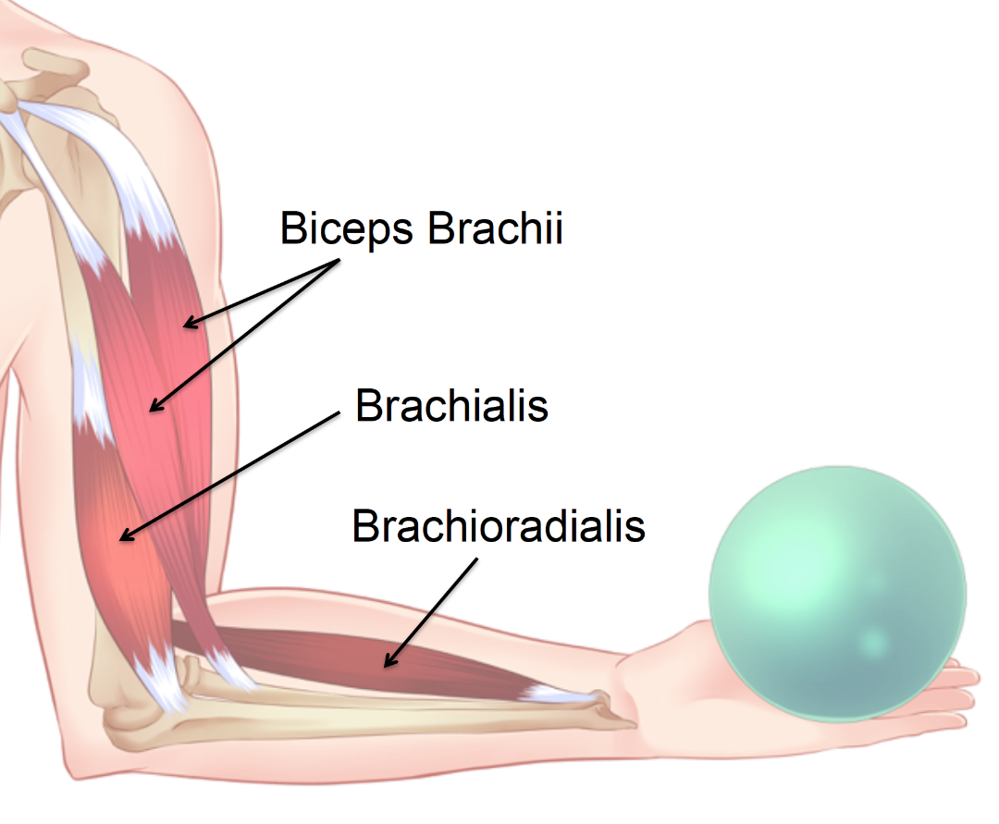

Slide 15
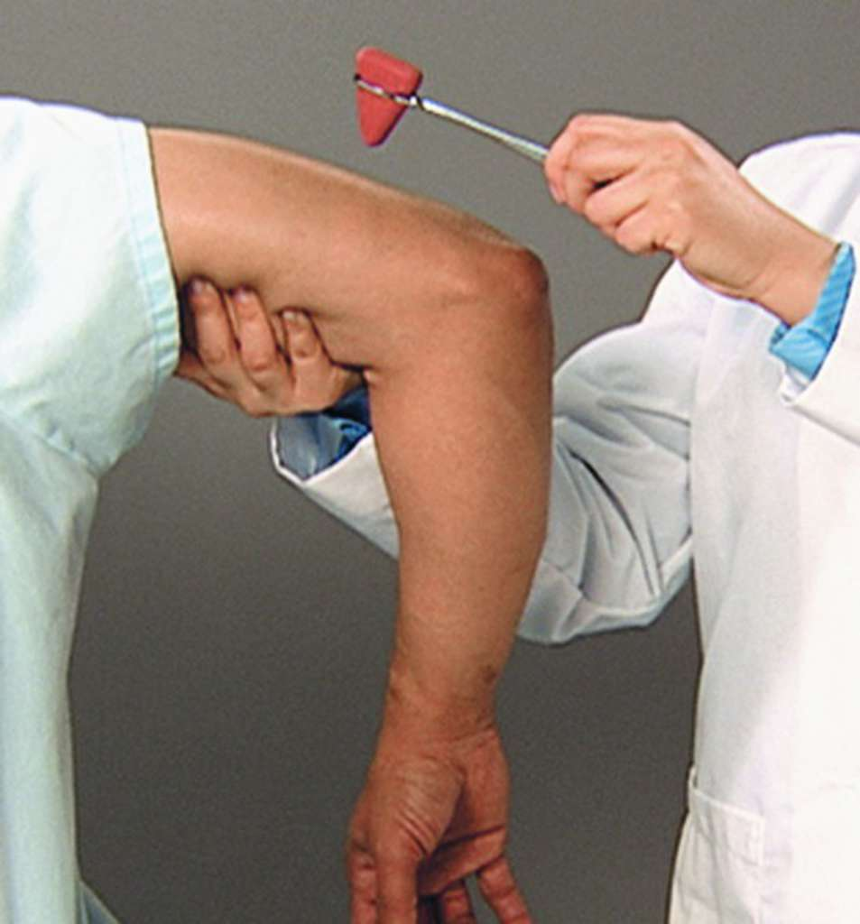
Triceps Reflex

Slide 16
Deep tendon reflexes
4. Patellar Reflex (L2-L4):
  Tapping the patellar tendon just below the kneecap.
  Response: Contraction of the quadriceps muscle, causing extension of the knee.
5. Achilles Reflex (S1-S2):
  Tapping the Achilles tendon at the back of the ankle.
  Response: causing plantar flexion of the foot.
6. Jaw Jerk Reflex:( trigeminal N)
  Tapping the middle of the chin while the mouth is slightly open.
  Response: Contraction of the masseter and temporalis muscles, causing the jaw to jerk upwards.
Notes:
Achilles Reflex (S1-S2):
Tapping the Achilles tendon at the back of the ankle.
Response: Contraction of the gastrocnemius and soleus muscles, causing plantar flexion of the foot.

Slide 17
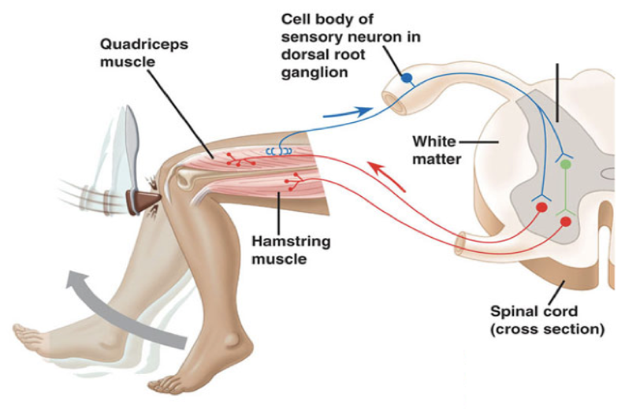
Patellar Reflex

Slide 18
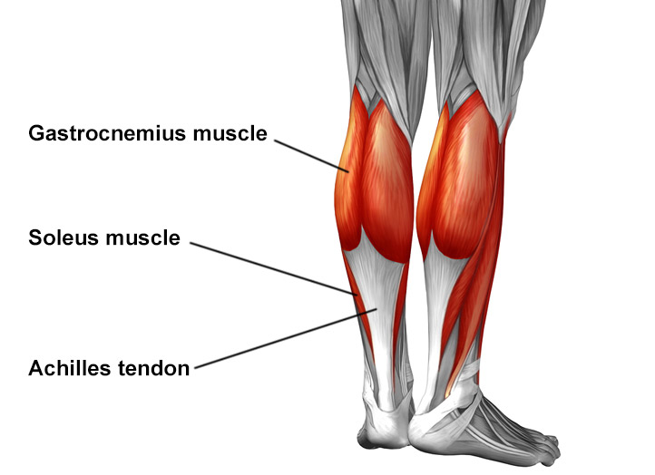

Slide 19
Upper Motor Neuron Lesions
UMN lesions occur in the neurons that originate in the motor region of the cerebral cortex or the brainstem and travel down to the spinal cord, where they synapse with lower motor neurons (LMNs).
Common Causes: Stroke, spinal cord injury, multiple sclerosis, cerebral palsy, traumatic brain injury, and neurodegenerative diseases
Notes:
Multiple sclerosis is caused by immune system mistakenly attacking myelin in the central nervous system (brain, optic nerves, and spinal cord). It's not clear why this happens but it may be a combination of genetic and environmental factors.
Neurodegenerative disorders include:
Alzheimer's disease and other memory disorders.
Huntington's disease.
Parkinson's disease.
cerebral palsy is a group of conditions that affect movement and posture. It's caused by damage that occurs to the developing brain, most often before birth. Symptoms appear during infancy or preschool years and vary from very mild to serious. Children with cerebral palsy may have exaggerated reflexes

Slide 20
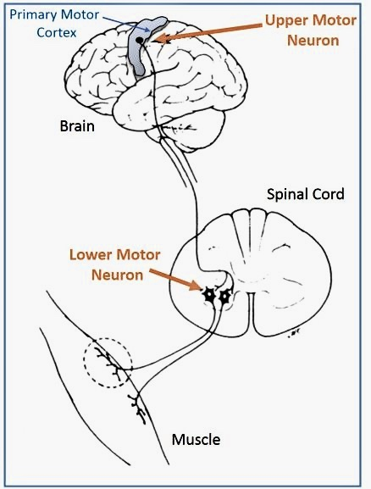

Slide 21
Lower Motor Neuron Lesions
Damage to the nerve cells that directly control muscle movements, which are located in the spinal cord and brainstem and their axons extend out to the muscles.
Common Causes: Spinal cord injury, peripheral nerve injury, poliomyelitis, amyotrophic lateral sclerosis (ALS), and other neuropathies.
Notes:
LMN lesions affect the motor neurons located in the anterior horn of the spinal cord or the cranial nerve nuclei
in the brainstem and their axons, which project to skeletal muscles.
Poliovirus-induced destruction of motor neurons of the anterior horn of the spinal cord and brain stem cells results in distinctive paralysis.
in ALS eventually leads to their death. When the motor neurons die, the ability of the brain to initiate and control muscle movement is lost. With voluntary muscle action progressively affected, patients in the later stages of the disease may become totally paralyzed.

Slide 22
Motor neuron lesion
There are two types of motor neuron lesion:
Upper motor neuron lesion (UMNL)
  Deep reflexes are exaggerated
  Superficial reflexes are lost
  Babniski’s sign become positive (upward planter response)
Lower motor neuron lesion (LMNL)
Deep and superficial reflexes are lost
Babniski’s sign become negative (downward planter response)

Slide 23
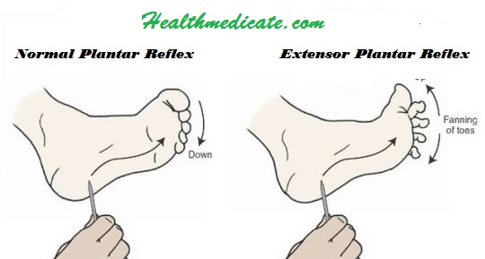

Slide 24


